Slide 1
Grouping and aggregating
Summarizing temporal data
Link to presentation:

Slide 2
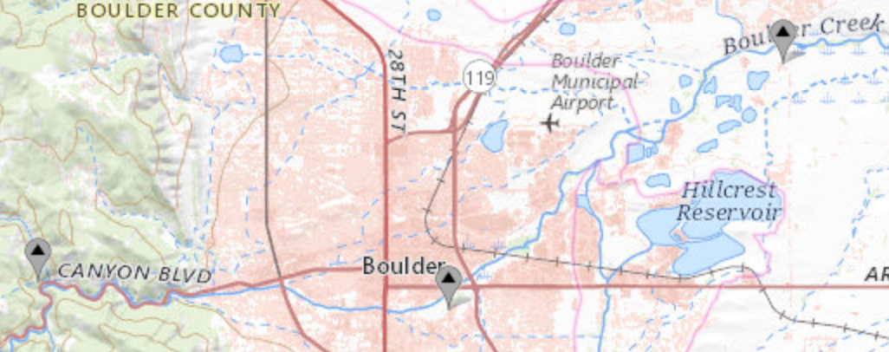
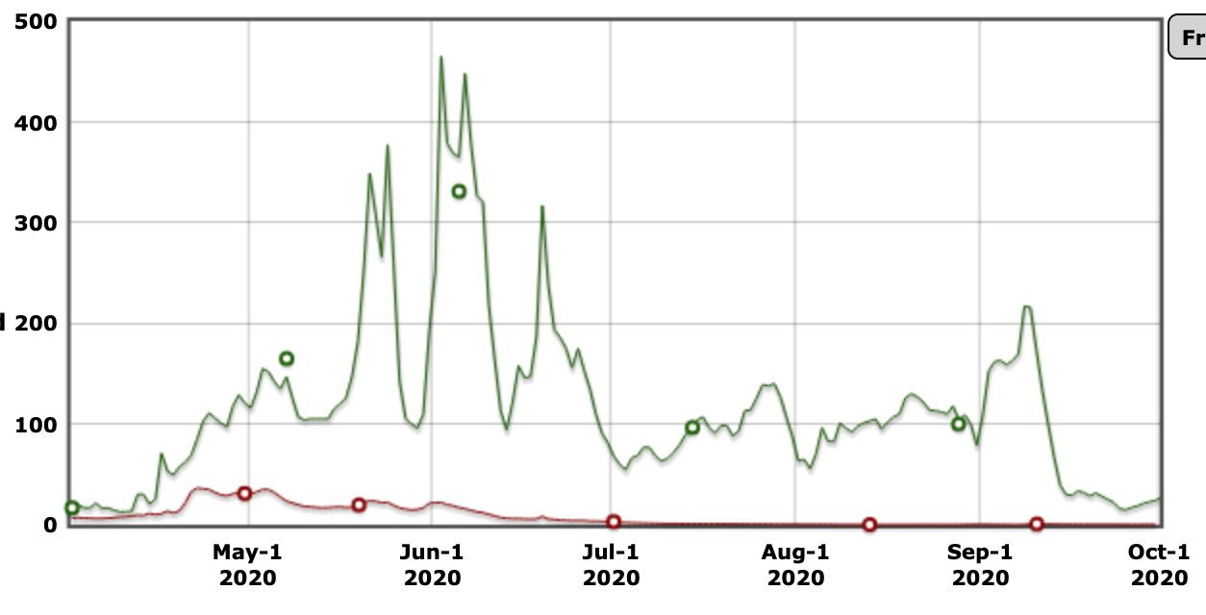
Example data: Ten years of streamflow data from two gauges on Boulder Creek
Downstream
gauge
Upstream
gauge
Daily discharge (cfs)
What can these data tell us about streamflow in streams of different sizes?
Notes:
Pair and share

Slide 3
To answer some questions about these data, we need to summarize, or aggregate, the data:
How much of the streamflow at the downstream gauge comes from the upstream gauge’s branch, on average?
Is the pattern of monthly streamflow the same or different for each of these gauge locations?
Which of the gauges has the most variability (normalized by the maximum value) in monthly and daily streamflow?
Notes:
Pick one of these questions. What steps would you need to take to calculate the answer?

Slide 4

A function that aggregates data takes many data points and returns a single number that describes them all.
For example:
Average
Minimum or maximum
Standard deviation
Median
Range
Sum
Count

Slide 5
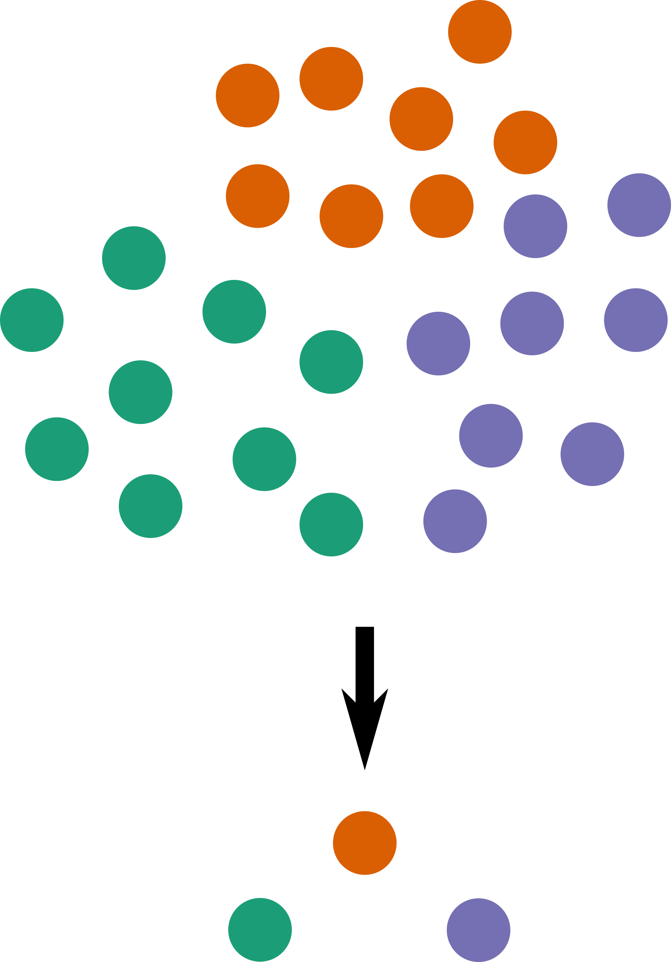
Often, aggregating functions are used to compare groups of data with different properties
To do this using Python, we must put the data in groups before aggregating. For example:
By date, month, year, or time
By location
By type of measurement
By a categorical variable
By cluster
By event of interest

Slide 6
Grouping and aggregating using Python and pandas
pandas.DataFrame.groupby(by)
Set the variable(s) you want to use to group the data. Does not change the DataFrame
pandas.DataFrame.agg(func)
Applies func (a single function or list of functions) to return one row for each group
Special aggregating functions like mean(), max(), and min() are also available
pandas.DataFrame.transform(func)
Performs func on every element in a DataFrame or column
func can use aggregate values for groups:
e.g. func = lambda x: x / max(x) would divide each row by the group maximum

